Slide 1
SmartHirePRO
Team Kodak

Slide 2
TABLE OF CONTENTS.
01
02
03
04
05
06
Project Description
Diagrams
Backlogs
User stories or Tasks
Metrics
LIVE Project Demo

Slide 3






TEAM MEMBERS
Hrushikesh
Joshi
Yadu Vamsi U
Sujay Sail
Devops Engineer
Aashlesha Shirole
Front-end Developer
Seungah Choi Full Stack Developer
Backend / Data
Engineer
Full Stack Developer
Sreeja Reddy Karukonda QA Analyst and DBA

Slide 4


TEAM MEMBERS CONT.
Ashish Sudam Data Engineer
Yash Jani Front-end Developer, Site reliability engineering (SRE)

Slide 5
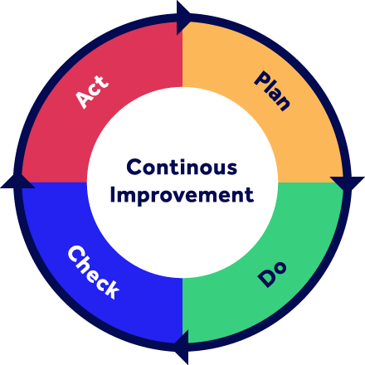
Improvements!
<p> Action items are more specific on the retrospectives </p>
<p> Specific algorithms are added </p>
<p> Architecture diagram is improved </p>
<p> Improved test cases</p>
Notes:
seungah

Slide 6
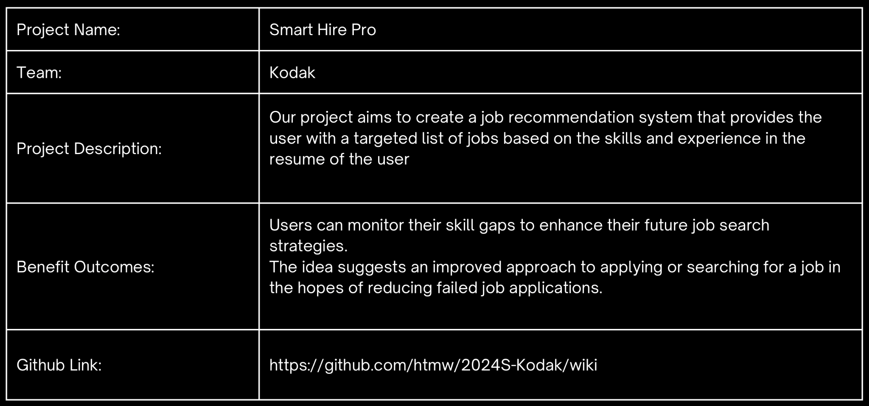
PROJECT DESCRIPTION

Slide 7
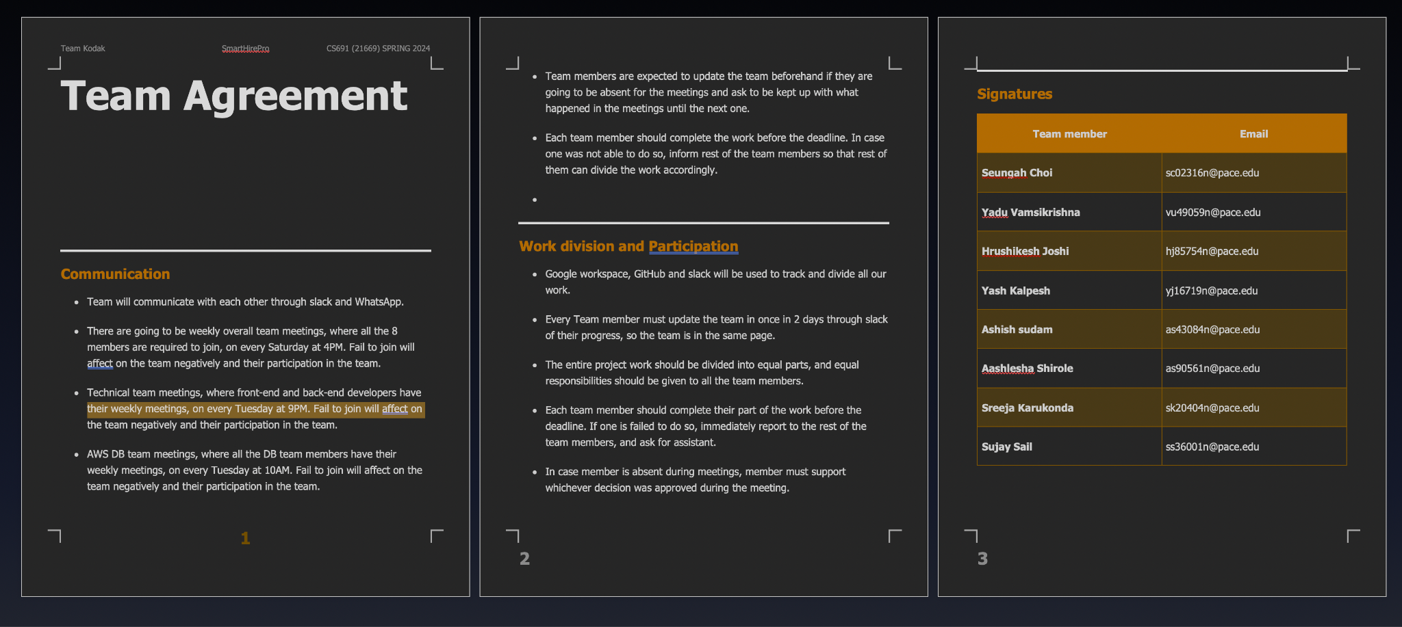
Team Working Agreement

Slide 8

Maria, the Ambitious Software Engineer
Demographics: Age:24 Location:New Jersey,U.S Education:Bachelor of Technology in Computer Science Experience: none
Skills and Qualifications: Proficient in Python, Java Experience with web development
Goals and Needs: Looking for challenging and rewarding software engineering role that utilizes her skills and experience. Wants to find a job that aligns with her interests and career aspirations.
"I'm tired of spending hours searching for jobs that aren't right for me. This platform seems like a great way to ﬁnd relevant opportunities that match my skills and career goals."

Slide 9

Audrey, Film editor
Demographics:
Age: 24
Location: Amsterdam, Netherlands
Education: Bachelor of Arts in Film
Experience: none
Skills and Qualifications:
Proficient in adobe suites, Avid Video
Experience with filming with a 16mm camera
Strong communication
Great teamwork abilities
Goals and Needs:
Searching for a full-time opportunity that uses her degree
To have a personal assistant-like tool that will suggest as many jobs as there are in the market

Slide 10

Daiman, Technical Support Assistant
Demographics:
Age: 27
Location: Birmingham, UK
Education: Bachelor's Degree in IT
Experience: 2 yrs
Skills and Qualifications:
Experience in Technical Support
Certified AWS CPP
100 hrs plus Data Science courses completed
Competed in multiple hackathons based on machine learning on HackerEarth
Goals and Needs:
Determine to change career paths from technical support to a career in Data science
After countless unfruitful applications, looking job recommendations that encapsulates all his recently acquired skills

Slide 11
MVP
Core Functionality:
Resume Parsing:
Basic skill and experience extraction using pre-trained models or simple keyword matching.
No complex semantic analysis or advanced natural language processing (NLP) at this stage
Job Search:
Connect to the external Jobseeker API using basic search capabilities based on extracted keywords from the resume.
Initially, return a simple list of matching jobs without ranking or compatibility scoring.
User Interface:
Simple web interface:
Allow users to upload their resumes and receive a list of relevant job postings from reed.co.uk.
No fancy features or complex navigation at this stage.
Metrics and Feedback:
Track basic usage metrics like number of users, resumes uploaded, and job searches conducted.
Gather user feedback through surveys or interviews to understand their experience and pain points.
Key Learnings:
Validate the core concept of using Al to recommend jobs based on resumes.
Identify the most valuable features and functionalities to prioritize in future development.
Gain insights into user behavior and preferences to refine the product roadmap.

Slide 12
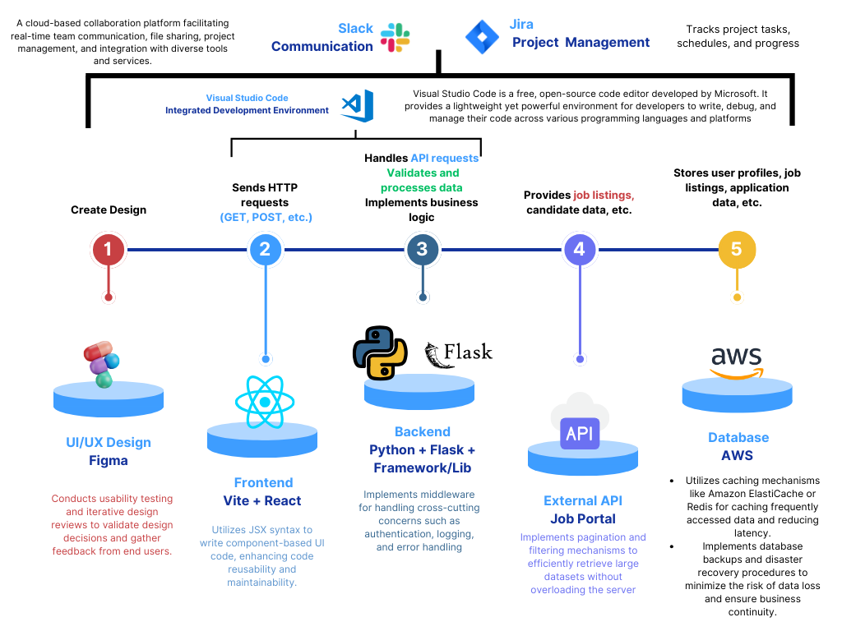
TECHNOLOGIES

Slide 13
ALGORITHMS
Text Extraction using Regular Expressions -
Contact number - (?:(?:\+?([1-9]|[0-9][0-9]|[0-9][0-9][0-9])\s*(?:[.-]\s*)?)?(?:\(\s*([2-9]1[02-9]|[2-9][02-8]1|[2-9][02-8][02-9])\s*\)|([0-9][1-9]|[0-9]1[02-9]|[2-9][02-8]1|[2-9][02-8][02-9]))\s*(?:[.-]\s*)?)?([2-9]1[02-9]|[2-9][02-9]1|[2-9][02-9]{2})\s*(?:[.-]\s*)?([0-9]{4})(?:\s*(?:#|x\.?|ext\.?|extension)\s*(\d+))?'
Email - ([^@|\s]+@[^@]+\.[^@|\s]+)

Slide 14
ALGORITHMS
Extract Name of Job-Seeker from Resume -
Load Spacy model - Initialize pre-trained small english language model (‘en_core_web_sm’)
Initialize Matcher - Matcher class of spacy is used to identify patterns in text
Tokenize text using nlp.
Define Pattern - Define a sequence of two proper nouns (PROPN)
Match Pattern - Using Matcher
Extract Name

Slide 15
ALGORITHMS
Extract keywords using YAKE (Yet Another Keyword Extraction) -
We chose this model after considering multiple models as we wanted to extract top keywords. YAKE provides a relevance score for keywords.
Algorithm -
Configure parameters for YAKE.
Compare extracted keywords with pre-defined skills
Use top n keywords for job search

Slide 16
ALGORITHMS
Generate a Match Score for a Job -
Another pre-trained Spacy model (‘en_core_web_lg’) is used to generate a Match Score for the resume and job.
Algorithm-
The model converts words in texts into high dimensional vectors i.e. Word Embeddings.
Then the process of Sentence Vectorization is performed.
Then similarity score is calculated for the sentence vectors using cosine similarity.

Slide 17
DIAGRAMS

Slide 18
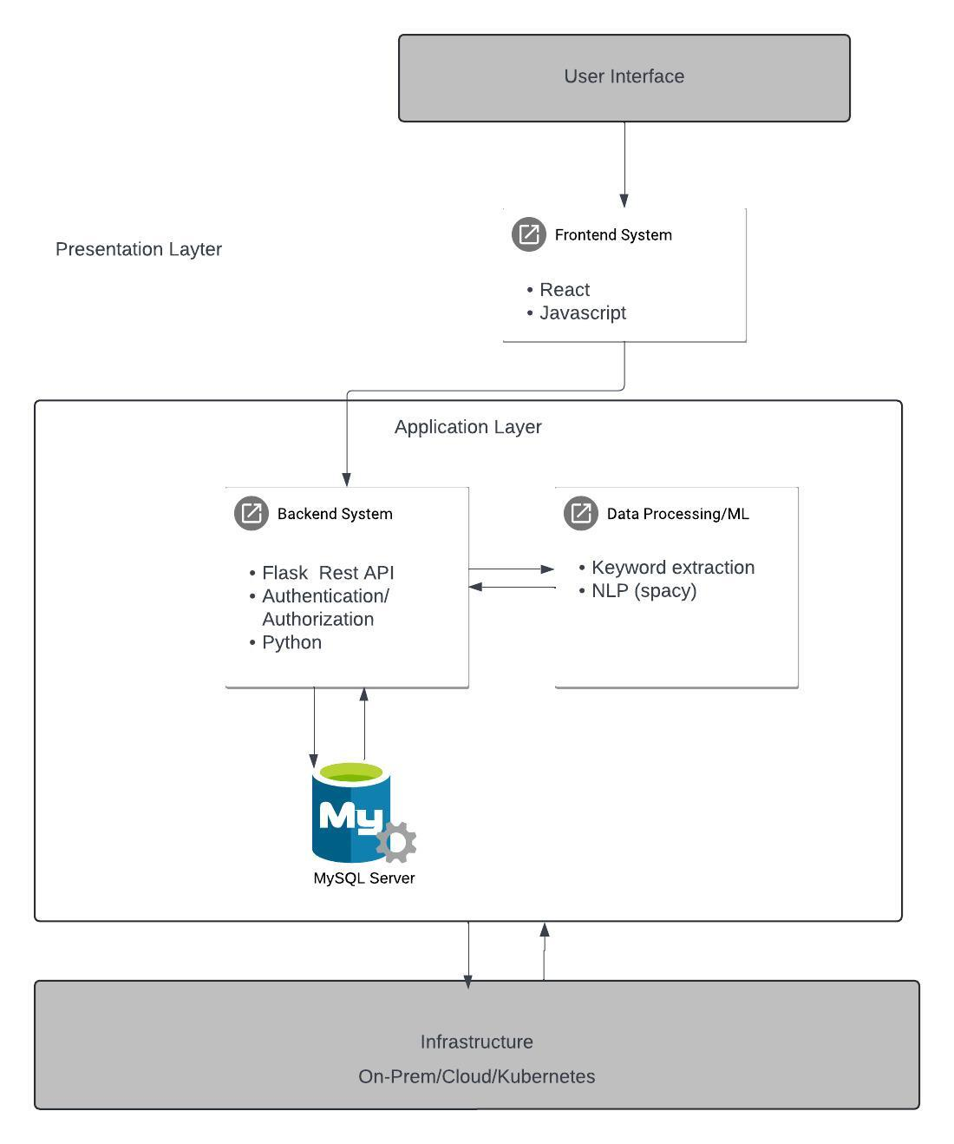
Architecture Diagram

Slide 19
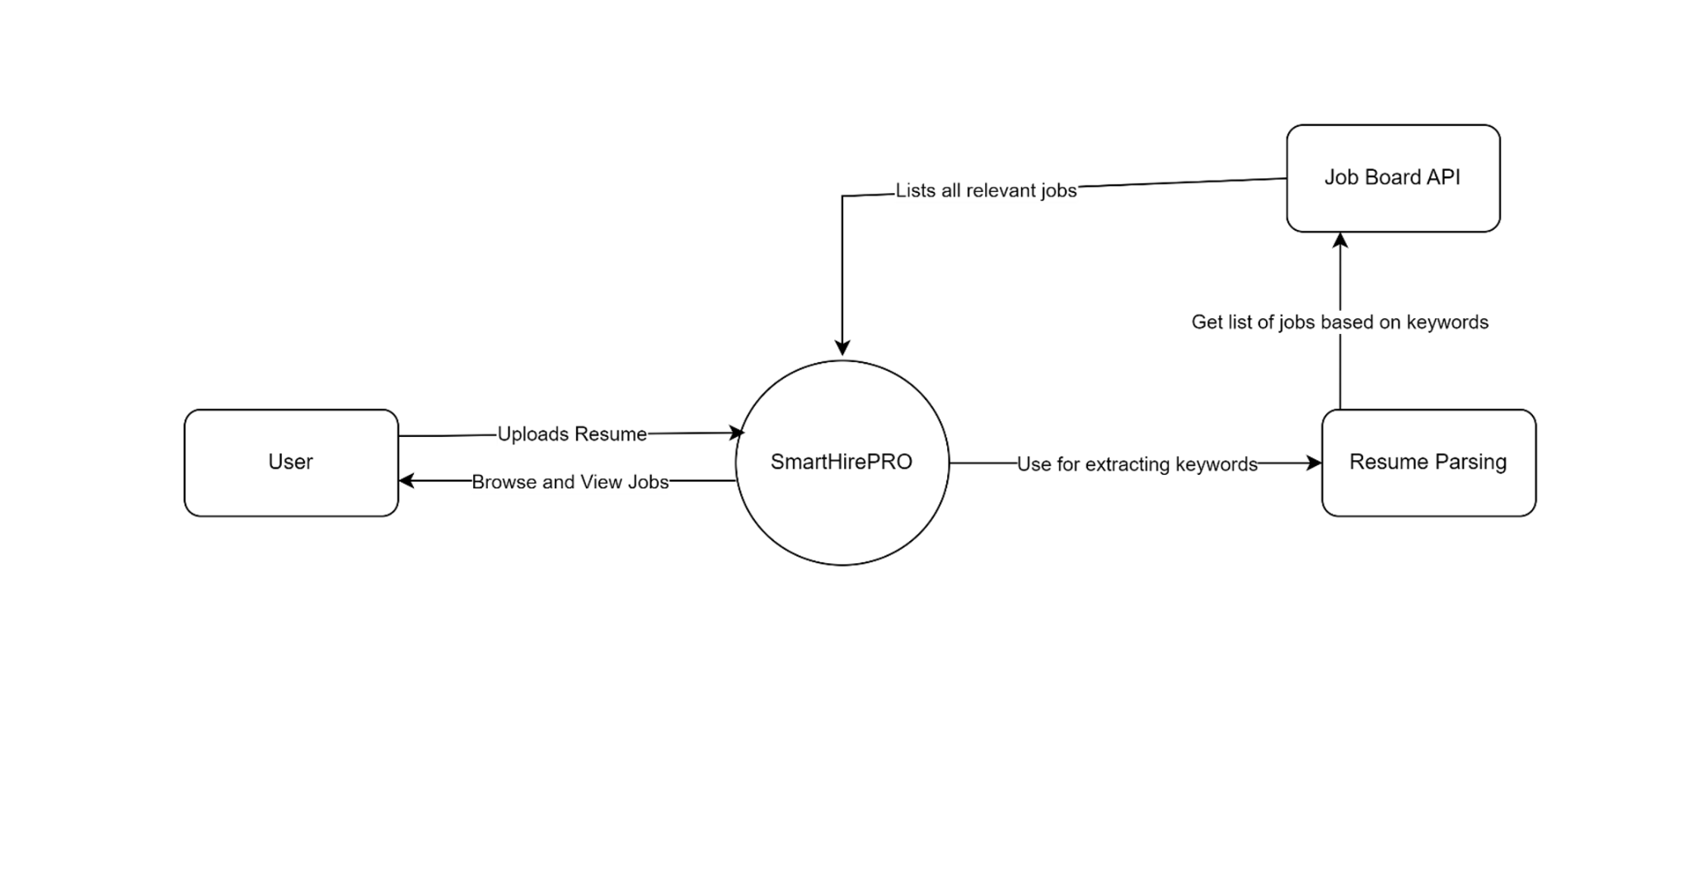
Context Diagram

Slide 20
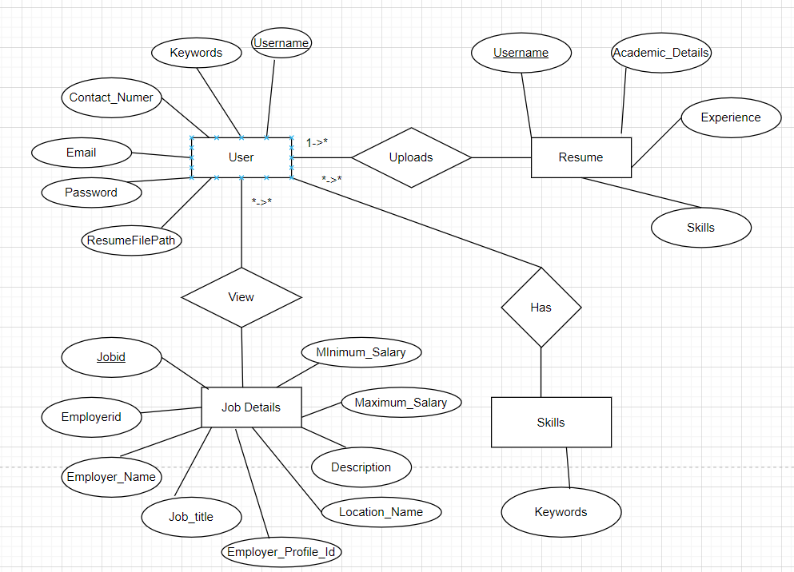
ER Diagram

Slide 21
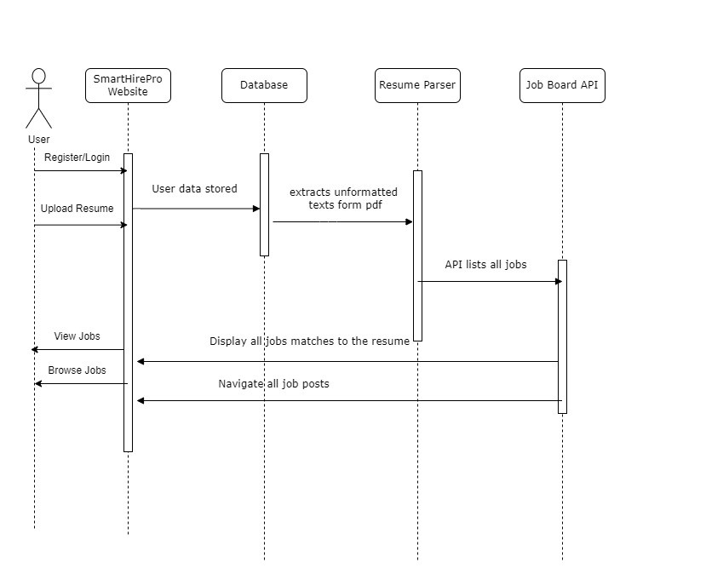
Sequence Diagram

Slide 22
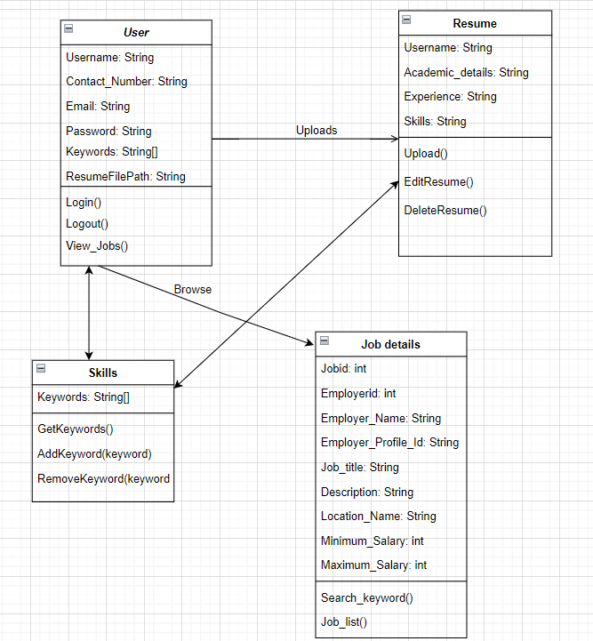
Class Diagram

Slide 23
Sprint 2 Recap
Created resume upload page where users can upload resume
Created dashboard so that user can see job list and match job score
Created backend utilities to extract information from resume.

Slide 24
Product Backlog
Issue Type | Key | Summary | Status
Story | SCRUM-3 | create a database to record user details | Done
Task | SCRUM-5 | Create a model to compare the similarity of a job description and user skills | In Progress
Task | SCRUM-6 | create backend utility to parse job data from the job board api | Done
Story | SCRUM-7 | Create a config file to store configuration of job board api and database connection details | Done
Task | SCRUM-11 | Create sign up page where users can register on the SmartHirePro app | Done
Task | SCRUM-12 | Create login page for the users to navigate through their account | Done
Story | SCRUM-14 | Integrate the app with a file system server | To Do
Task | SCRUM-15 | expand job search to include other job boards beyond Reed.co.uk | To Do

Slide 25
Product Backlog Cont.
Issue Type | Key | Summary | Status
Story | SCRUM-16 | should implement job ranks based on keyword matching between resume and job descriptions | To Do
Story | SCRUM-17 | create a filter to search user-defined keywords( location, salary range, company size, or job type) | To Do
Story | SCRUM-18 | create flexibility in resume input(docx ,pdf ,txt) | To Do
Task | SCRUM-37 | design and create database tables | In Progress
Task | SCRUM-38 | configure EC2 instance to execute working environments for the app | To Do
Task | SCRUM-39 | configure AWS RDS MySQL to connect with backend python utilities | Done
Task | SCRUM-40 | Create a Home page to be the starting page of the website. Also link to the other pages such as;login,signup,upload pages. | Done

Slide 26
User Stories
ID | User Stories | Summary | Status
1 | As a software engineer I want to be able to browse through Software engineer jobs so that I can review jobs that I want to apply | Scenario: User is job hunting Given I'm a software engineer When I click on a job Then SmartHirePro should provide me with a list of relevant jobs. | Completed
2 | As an IT Student I want to be able to upload my resume so that I get a list of jobs based on my skills. | Scenario: User is seeking for jobs Given I'm an IT Student When I upload my resume Then I am provided with a curated list of IT-related jobs. | Completed

Slide 27
User Stories Cont.
ID | User Stories | Summary | Status
3 | As a job seeker I want to delve into the demands of the industry so that I can update myself to the industry standard. | Scenario: User wants to investigate jobs Given I'm a job seeker When I click on a job Then I can investigate the demands of job categories in the industry. | Completed
4 | As a film editor I want to devote my time to applying to only those jobs that suit my profile so that I increase my chances of getting hired. | Scenario: User is on a deadline for job hunting Given I'm a film editor When I am hunting for jobs Then I want to browse jobs that are suitable for my profile and skills match score | Completed

Slide 28
User Stories Cont.
ID | User Stories | Summary | Status
5 | As a backend developer I want to discover the values and detailed description of the employer and position. so that I can determine if my interests and technical skills are aligned with relevant job | Scenario: User is seeking a job that encompasses his skills and interests Given I'm a backend developer When I review a job description Then I should see the details of the job with programming language specification. | To Do
6 | As a Technical Support Assistant I want to switch my career path to data science so that I know I am applying for a job that matches my skills and is right for me. | Scenario: User is hunting for a job in another domain Given I'm a technical support assistant When I browse through a job Then SmartHirePro should provide job match and skills score for data science jobs | Completed

Slide 29
User Stories Cont.
ID | User Stories | Summary | Status
7 | As a student I want to be able to search internship job list so that I can browse internship opportunities relevant to my skills and apply. | Scenario: User is seeking an internship Given I'm a student When I see a job that is a match for my profile Then SmartHirePro should provide me list of internship opportunities | Completed

Slide 30
Sprint 3 Backlog
Issue Type | Key | Summary | Status
Story | SCRUM-3 | create a database to record user details | Done
Task | SCRUM-5 | Create a model to compare the similarity of a job description and user skills | In Progress
Task | SCRUM-6 | create backend utility to parse job data from the job board api | Done
Story | SCRUM-7 | Create a config file to store configuration of job board api and database connection details | Done
Task | SCRUM-11 | Create sign up page where users can register on the SmartHirePro app | Done
Task | SCRUM-12 | Create login page for the users to navigate through their account | Done
Story | SCRUM-18 | create flexibility in resume input(docx ,pdf ,txt) | To Do
Task | SCRUM-38 | configure EC2 instance to execute working environments for the app | To Do
Task | SCRUM-39 | configure AWS RDS MySQL to connect with backend python utilities | Done
Task | SCRUM-40 | Create a Home page to be the starting page of the website. Also link to the other pages such as;login,signup,upload pages. | Done

Slide 31
TEST CASES
TEST CASE ID | TEST SCENARIO | DESCRIPTION | EXPECTED OUTCOME | ACTUAL OUTCOME | PASS/FAIL
1 | Using PDF miner | The resume parser should successfully extract unformatted text from PDF resumes using the PDF miner agent. | Unformatted Text from user’s resume | Unformatted Text | Pass
2 | Using pre-trained language model | The resume parser should successfully extract the user’s name using pre-trained language model | User’s Name | User’s Name | Pass
3 | Using the regular expression | The resume parser should successfully extract the user contact number using regular expression | User’s Contact Number | Contact Number | Pass

Slide 32
TEST CASES CONTINUE...
TEST CASE ID | TEST SCENARIO | DESCRIPTION | EXPECTED OUTCOME | ACTUAL OUTCOME | PASS/FAIL
4 | Using regular expression | The resume parser should successfully extract the user’s email id using a regular expression. | User’s Email | Email ID | Pass
5 | Using YAKE | The resume parser should successfully extract the keywords using TextRank | Keywords representing skills of user | Extracted keywords from sample resume | Pass
6 | Job Board API (reed.uk) API | The job board API should successfully gather a list of jobs based on keywords. | List of jobs gathered from External API | Shown list of jobs | Pass

Slide 33
TEST CASES CONTINUE...
TEST CASE ID | TEST SCENARIO | DESCRIPTION | EXPECTED OUTCOME | ACTUAL OUTCOME | PASS/FAIL
7 | Display Job Information | The job board API should successfully retrieve and display detailed job information from reed.uk API for a specific job | Retrieve and display job information | Job Details for a job selected | Pass
8 | REACT upload link | The app should have a dedicated page with react based upload link for users to upload their resumes. | A Button to for Uploading Resume | Resume Upload Resume | Pass
9 | Dashboard page | The app should have a dashboard page that allows users to navigate through different sections. | A navigation bar to navigate through the app. | Navigation Bar | Pass

Slide 34
TEST CASES CONTINUE...
TEST CASE ID | TEST SCENARIO | DESCRIPTION | EXPECTED OUTCOME | ACTUAL OUTCOME | PASS/FAIL
10 | Display jobs using REACT | The app’s dashboard should have a page displaying a list of jobs using react. | List of jobs | List of jobs | Pass
11 | Display metric score | The app’s dashboard should display a metric score representing the match between a job and the user’s resume using react. | Relevance Score | Score Displayed | Pass

Slide 35
SPRINT-3 STORY COMPLETION
ESTIMATION | USER ID | POSITION As a | NEED TO / WANT TO | IN ORDER TO | FEATURE | STATUS
1 | 1 | Software Engineer | I want to able to browse through jobs | So, that I can review jobs that I want to apply. | List of jobs | Completed
1 | 2 | IT Student | I want to able to upload my resume | So that I can get list of jobs based on my skills | Keyword Extraction | Completed
2 | 3 | Job Seeker | I want to delve into the demand of industry | So that I can myself according to the industry standards | Regular expression | Completed

Slide 36
ESTIMATION | USER ID | POSITION As a | NEED TO / WANT TO | IN ORDER TO | FEATURE | STATUS
2 | 4 | Film Editor | I want to devote my time to applying to only those jobs that suit my profile. | So that I can increase my chances of getting hired | Keyword Extraction | Completed
5 | 5 | Backend Developer | I want to discover the values and specifies of the employer and position. | So that I can determine if my interests and skills are aligned. | Regular Expression | Completed
8 | 6 | Job Seeker | I want to know if a job matches my profile | So that I know I am applying to a job that right for me. | reed.uk API | Completed

Slide 37
STORIES NOT COMPLETED
ID | ITEMS | DESCRIPTION | STATUS | DATE
1 | SCRUM-5 | Create a model to compare similarity of a job description and user skills | IN PROGRESS | 10 APR
2 | SERUM-18 | Create flexibility in resume input (docx,pdf,txt) | TO DO | 10 APR
3 | SCRUM-40 | Create a Homepage to be the starting page of the website. Also link to the other pages such... | TO DO | 10 APR

Slide 38
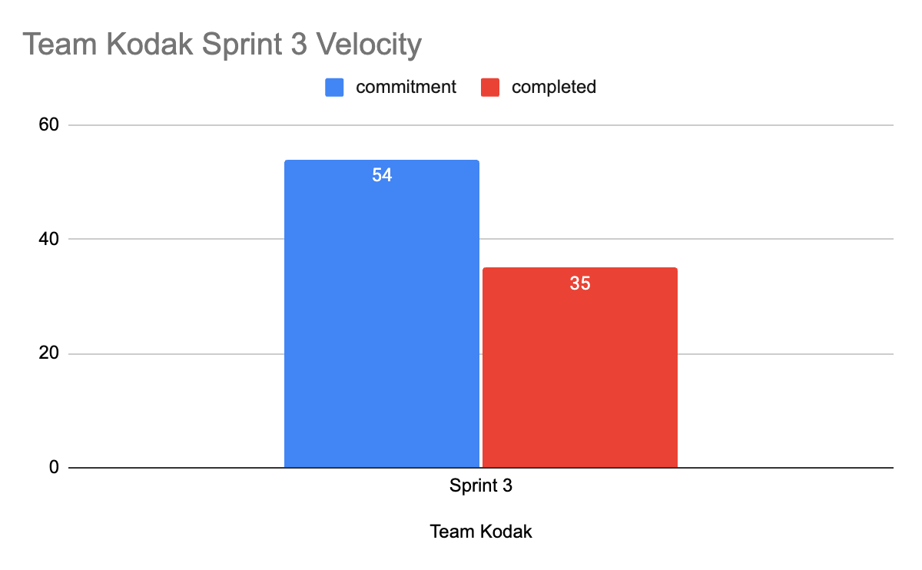
TEAM VELOCITY SPRINT 3
54 story points committed from the start of the sprint
35 total story points completed
Notes:
Story points are used

Slide 39
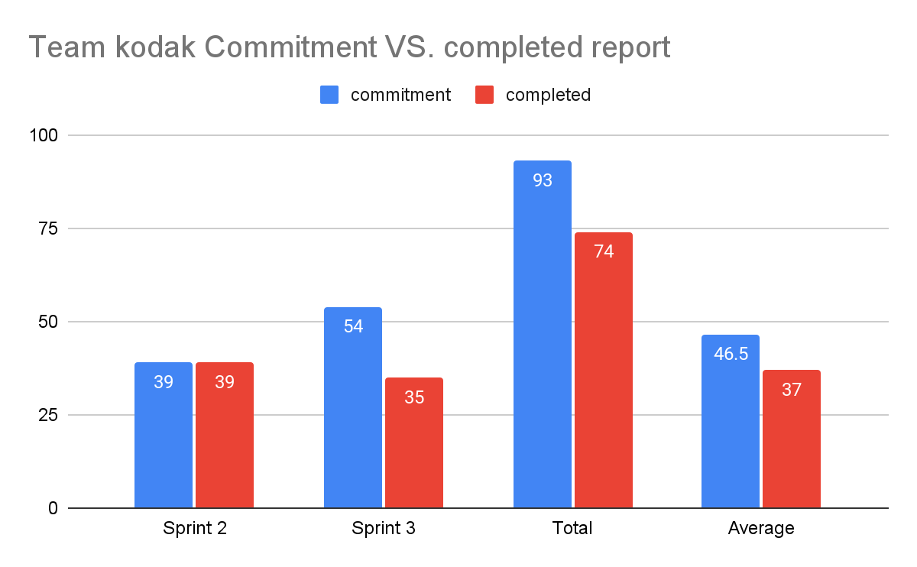
TEAM’S VELOCITY HISTORICAL + AVERAGE
Sprint 2: 39 commitments,39 completed
+
Sprint 3: 54 commitments,35 completed
=
93 commitments in total 74 completed in total
/2 = 46.5 commitments in average,37 completed in average

Slide 40
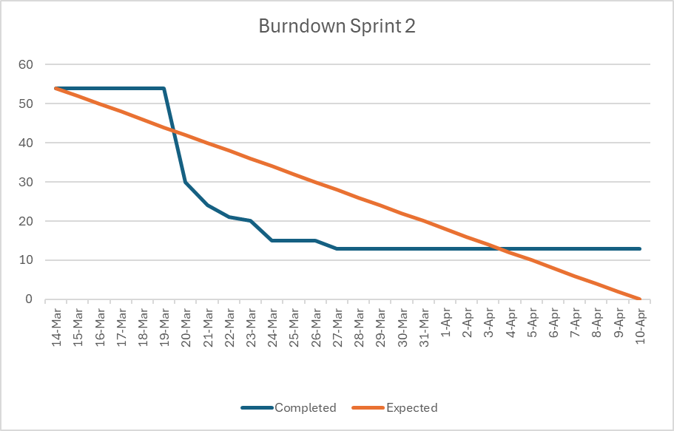
BURNDOWN CHART SPRINT 3
Notes:
seungah

Slide 41
DETAILS OF THE BURNDOWN CHART

Slide 42
Summary | story point | Custom field (Completed Date)
Create a Home page to be the starting page of the website. Also link to the other pages suchas;login,signup,upload pages. | 2 | 3/27/2024 0:00:00
configure AWS RDS MySQL to connect with backend python utilities | 3 | 22/Mar/24 12:00 AM
configure EC2 instance to execute working environments for the app | 5
create flexibility in resume input(docx ,pdf ,txt) | 1
create login page for the users to navigate through their account | 5 | 3/24/2024 0:00:00
create sign up page where users can register on the SmartHirePro app | 1 | 3/23/2024 0:00:00
create a config file to store configuration of job board api and database connection details | 8 | 20/Mar/24 12:00 AM
create backend utility to parse job data from the job board api | 13 | 20/Mar/24 12:00 AM
create a model to compare similarity of a job description and user skills | 13
create a database to record user details | 3 | 20/Mar/24 12:00 AM
TOTAL story points | 54
Notes:
seungah

Slide 43
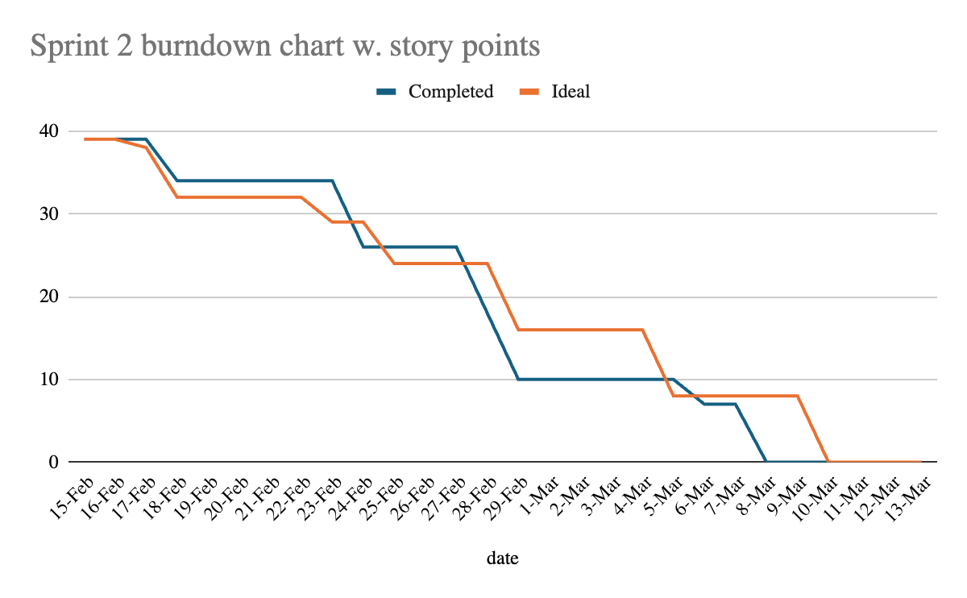
BURNDOWN CHART HISTORICAL
Notes:
Seungah All the previous burndown charts are converted to story points as well and took out the deliverable powerpoint or the retrospectives out of the sprint task list.

Slide 44
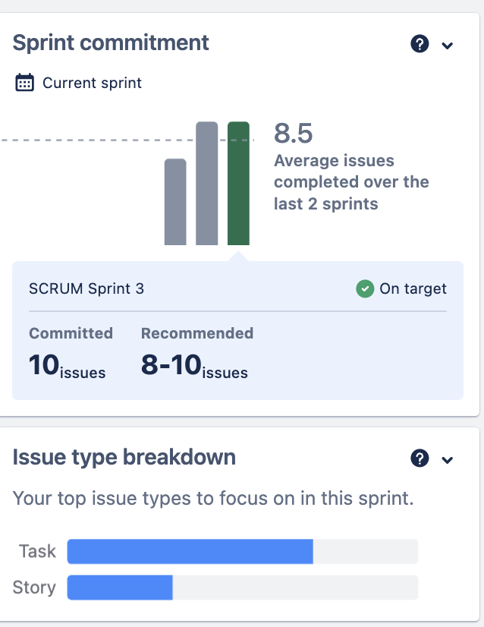
COMPLETED AND COMMITTED RATIO
TASK: 7 issues, 70% of the total issues committed
STORY: 3 issues, 30% of the total issues committed
Notes:
seungah

Slide 45
COMPLETED AND COMMITTED RATIO CONT.
Issue Type | Summary | Status | Created | Custom field (Completed Date) | Story Points
Task | Create a Home page to be the starting page of the website. Also link to the other pages suchas;login,signup,upload pages. | Done | 27/Mar/24 10:38 AM | 27/Mar/24 12:00 AM | 2
Task | configure AWS RDS MySQL to connect with backend python utilities | Done | 13/Mar/24 12:01 PM | 21/Mar/24 12:00 AM | 3
Task | configure EC2 instance to execute working environments for the app | To Do | 13/Mar/24 12:00 PM |  | 5
Story | create flexibility in resume input(docx ,pdf ,txt) | To Do | 12/Mar/24 2:36 PM |  | 1
Task | create login page for the users to navigate through their account | Done | 11/Mar/24 9:36 PM | 24/Mar/24 12:00 AM | 5
Task | create sign up page where users can register on the SmartHirePro app | Done | 11/Mar/24 9:35 PM | 23/Mar/24 12:00 AM | 1
Story | create a config file to store configuration of job board api and database connection details | Done | 11/Mar/24 9:04 PM | 20/Mar/24 12:00 AM | 8
Task | create backend utility to parse job data from the job board api | Done | 11/Mar/24 9:01 PM | 20/Mar/24 12:00 AM | 13
Task | create a model to compare similarity of a job description and user skills | In Progress | 11/Mar/24 9:00 PM |  | 13
Story | create a database to record user details | Done | 11/Mar/24 8:59 PM | 20/Mar/24 12:00 AM | 3
Done 65% 35/54≈0.65
Not started 11% 6/54≈0.11
IN PROGRESS 24% 13/54≈0.24

Slide 46
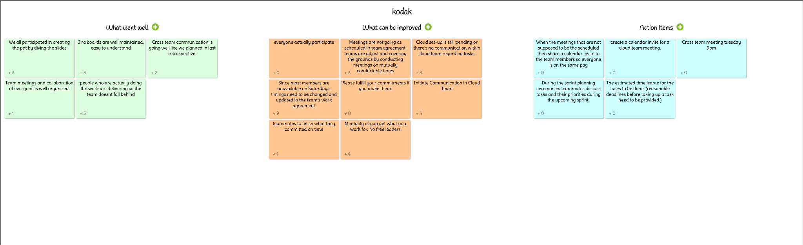
RETROSPECTIVES

Slide 47
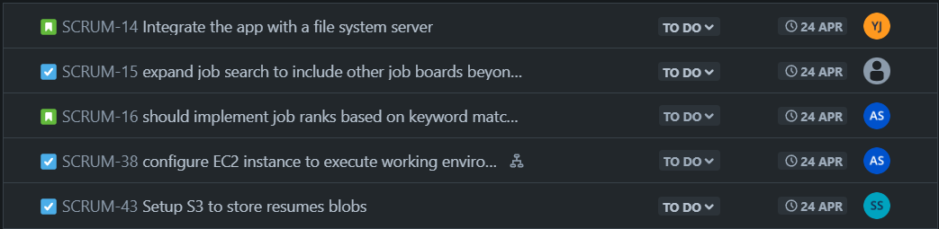
SPRINT 4

Slide 48
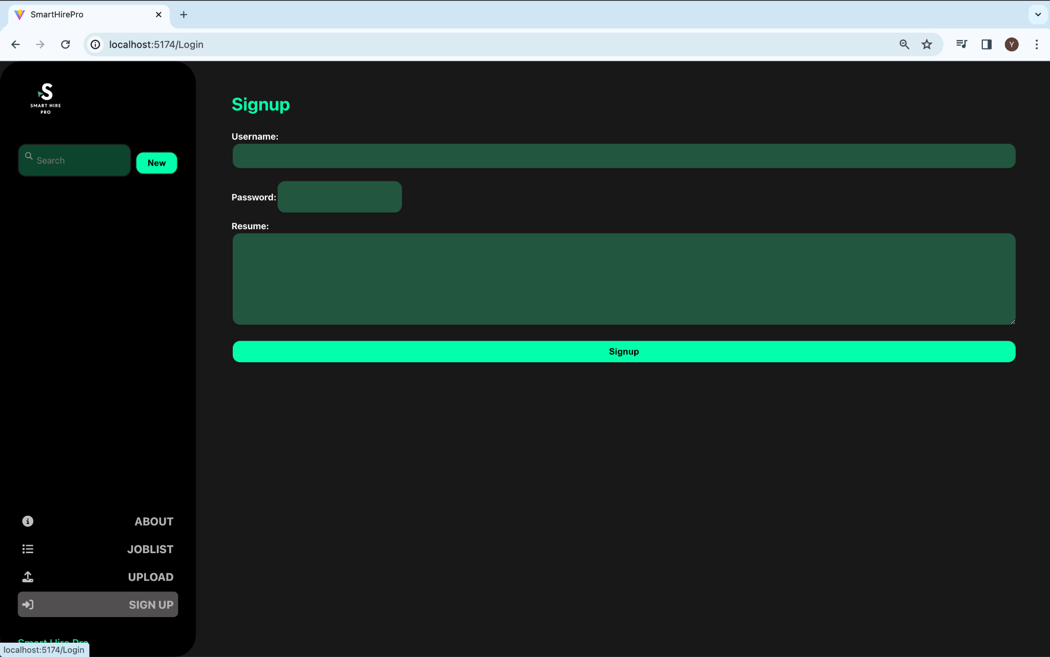
APP SCREENSHOT(Sign Up)

Slide 49
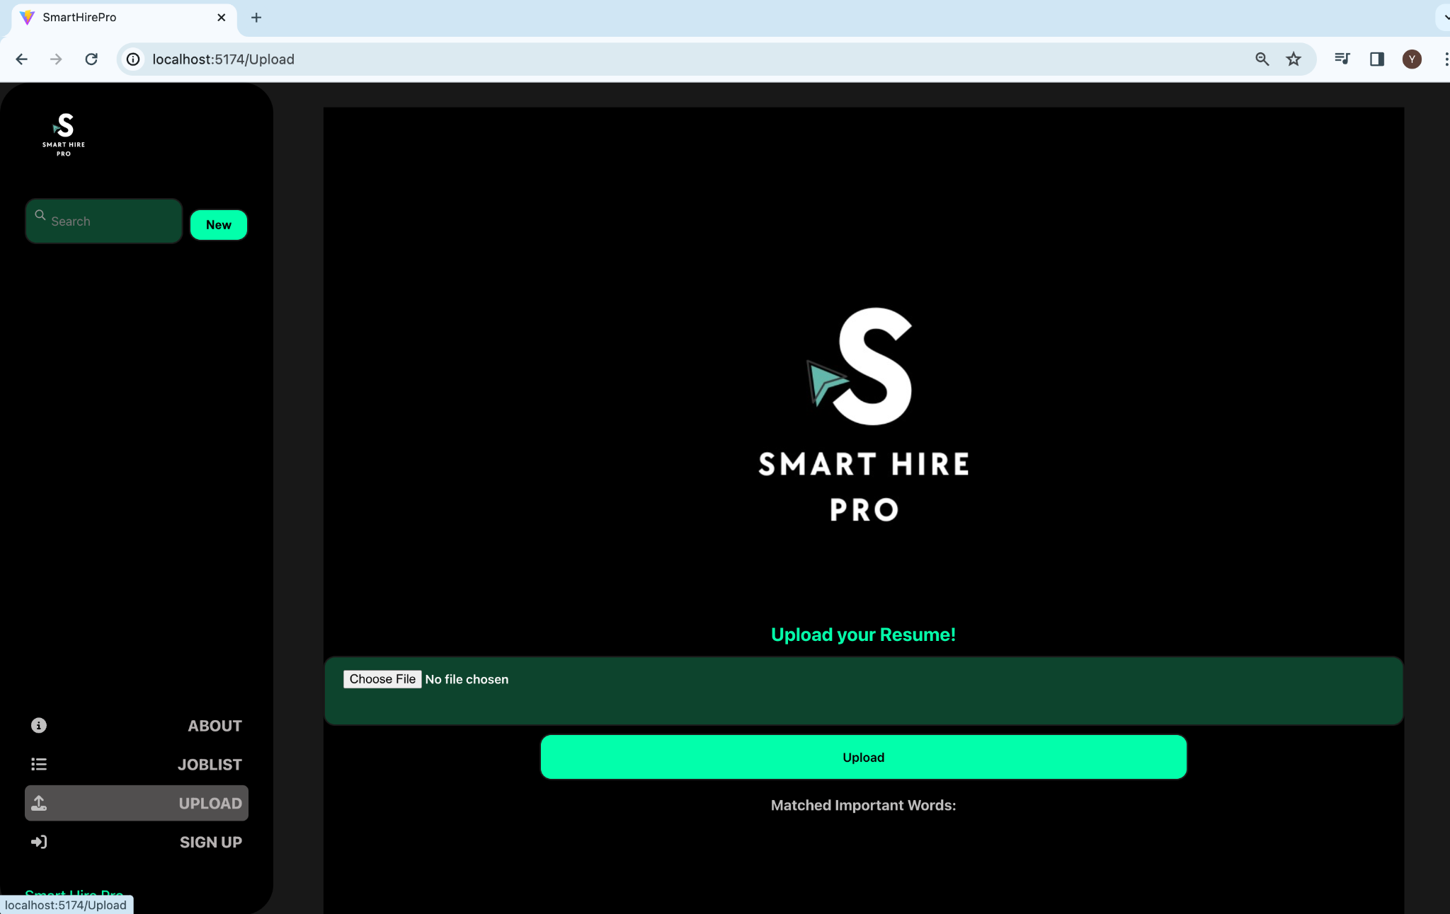
APP SCREENSHOT(Upload Page)

Slide 50
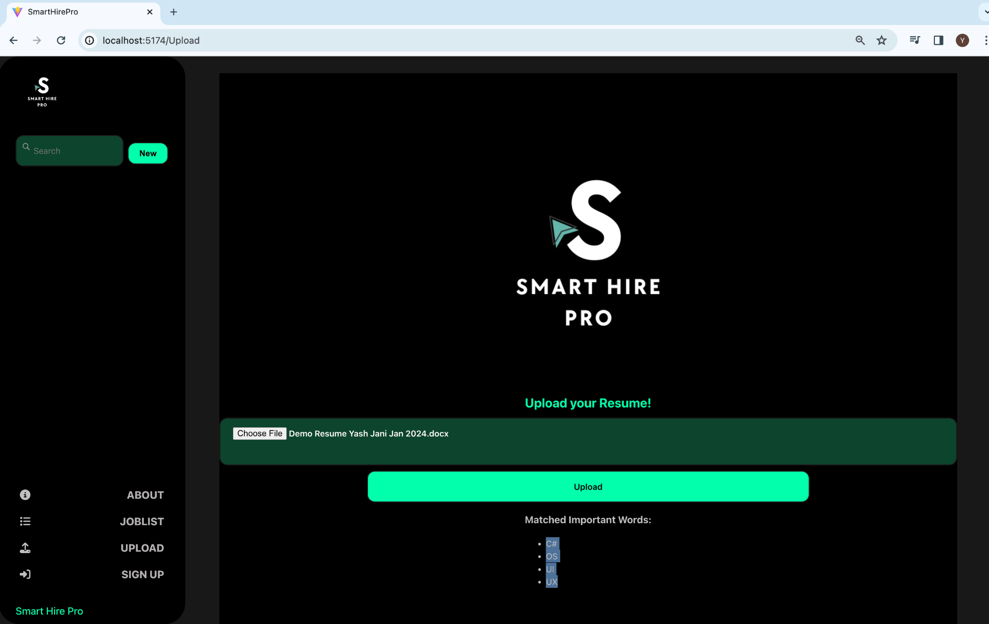
APP SCREENSHOT(Upload Page)

Slide 51
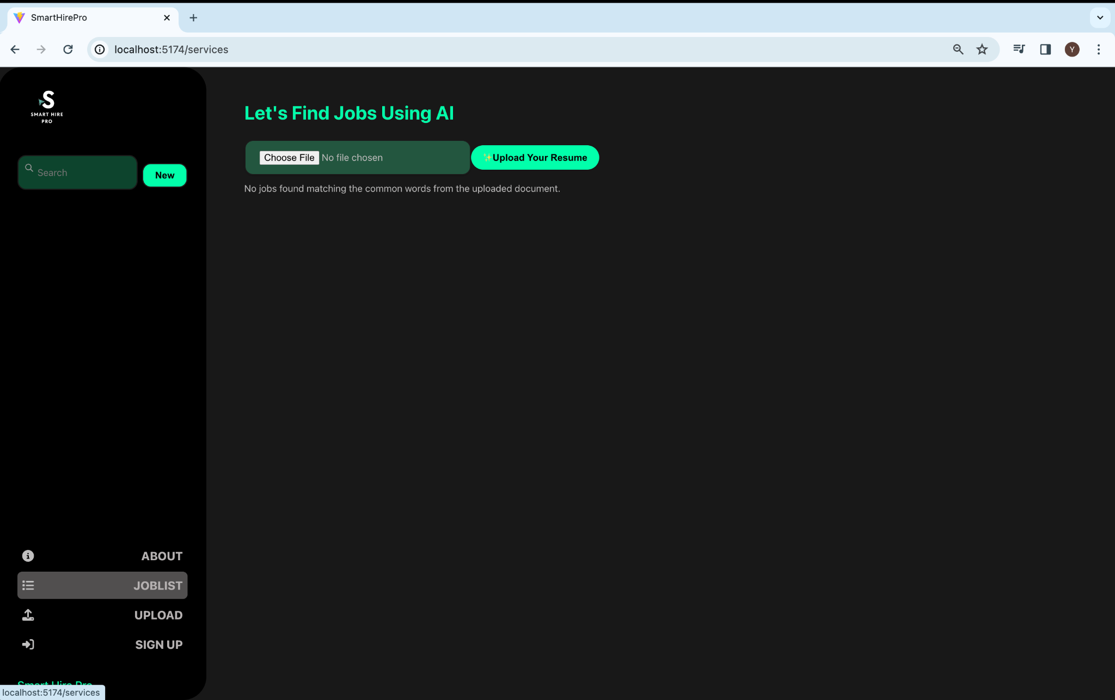
APP SCREENSHOT(Joblist)

Slide 52
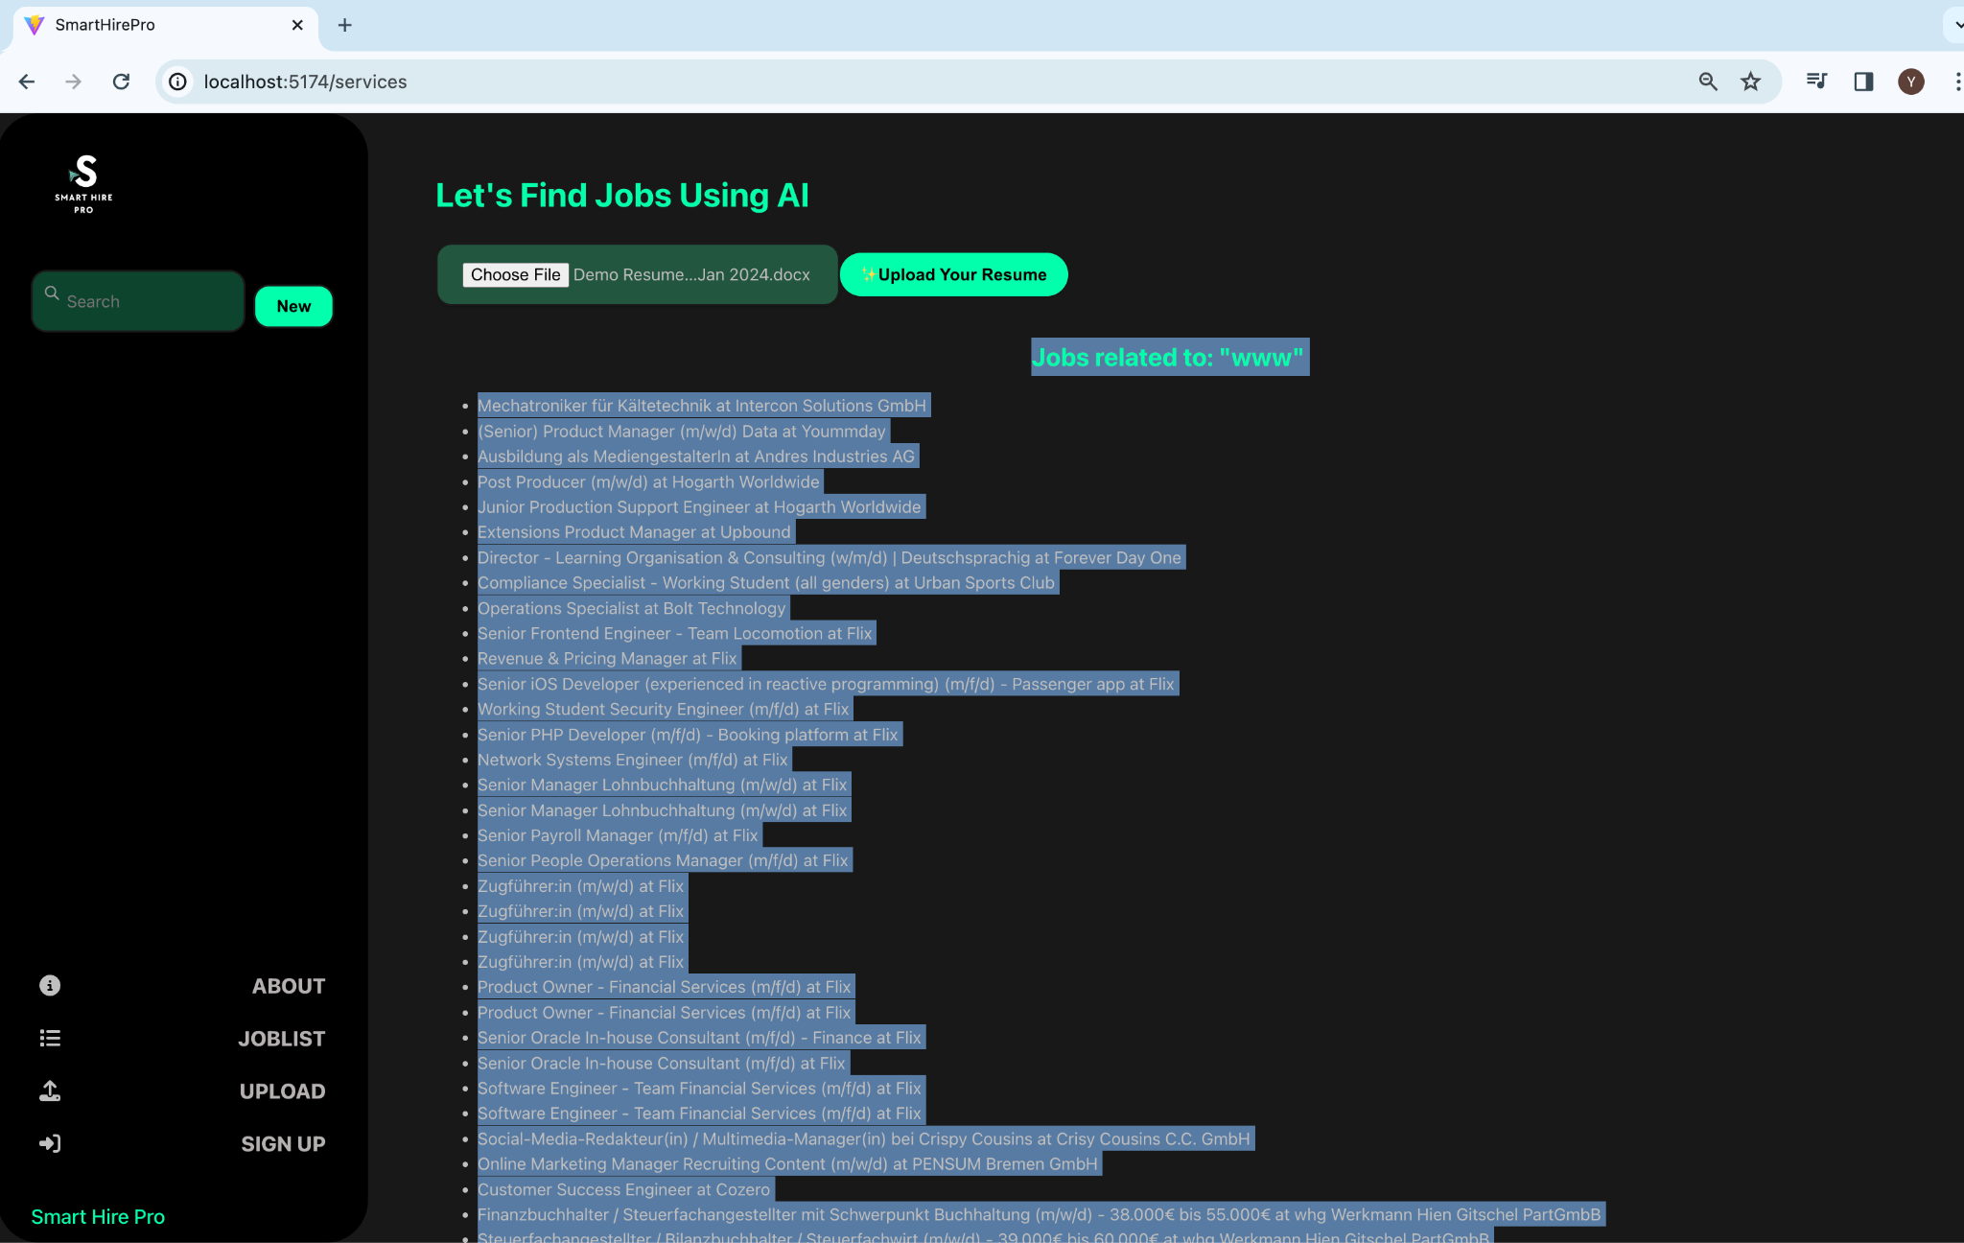
APP SCREENSHOT(Jobs Display)

Slide 53
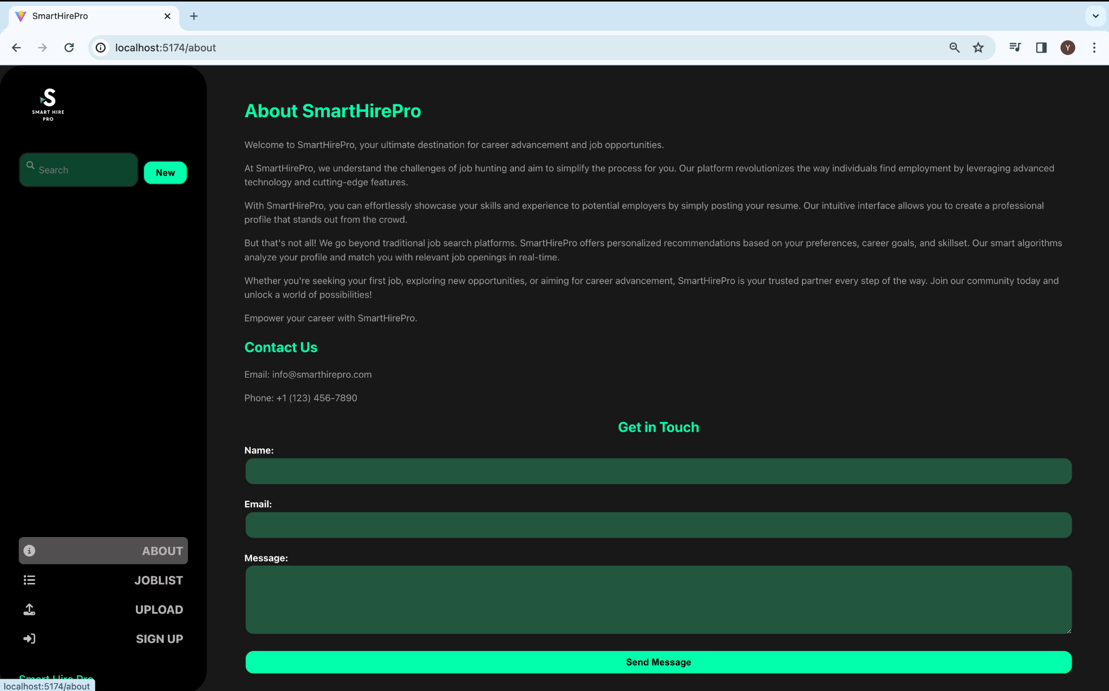
APP SCREENSHOT(About)

Slide 54
API
Register
Login
Upload
Endpoint -
/userauth/register?username=<username>&password=<password>&resume=<resume_text>
Return Codes -
1200 - Register Success
1100 - User Exist
Endpoint -
/userauth/login?username=<username>&password=<password>
Return Codes -
2200 - Login Success
2100 - User does not Exist
Endpoint -
/resume/upload?username=<username>&resume=<resume>
Return Codes -
3200 - Upload Success
3100 - Upload failed

Slide 55
API
Job Lists
Job Details
Match Score
Endpoint -
/jobs/list?username=<username>&page=<page>
Return Codes -
Jobs List - Success
4100 - Job Board API failed
Endpoint -
/jobs/detail?jobid=<jobid>
Return Codes -
Job Details - Success
Endpoint -
/jobs/score?username=<username>&job=<job description>
Return Codes -
Score - Success
6100 - Can’t be Scored

Slide 56
https://github.com/htmw/2024S-Kodak/wiki
GITHUB LINK

Slide 57
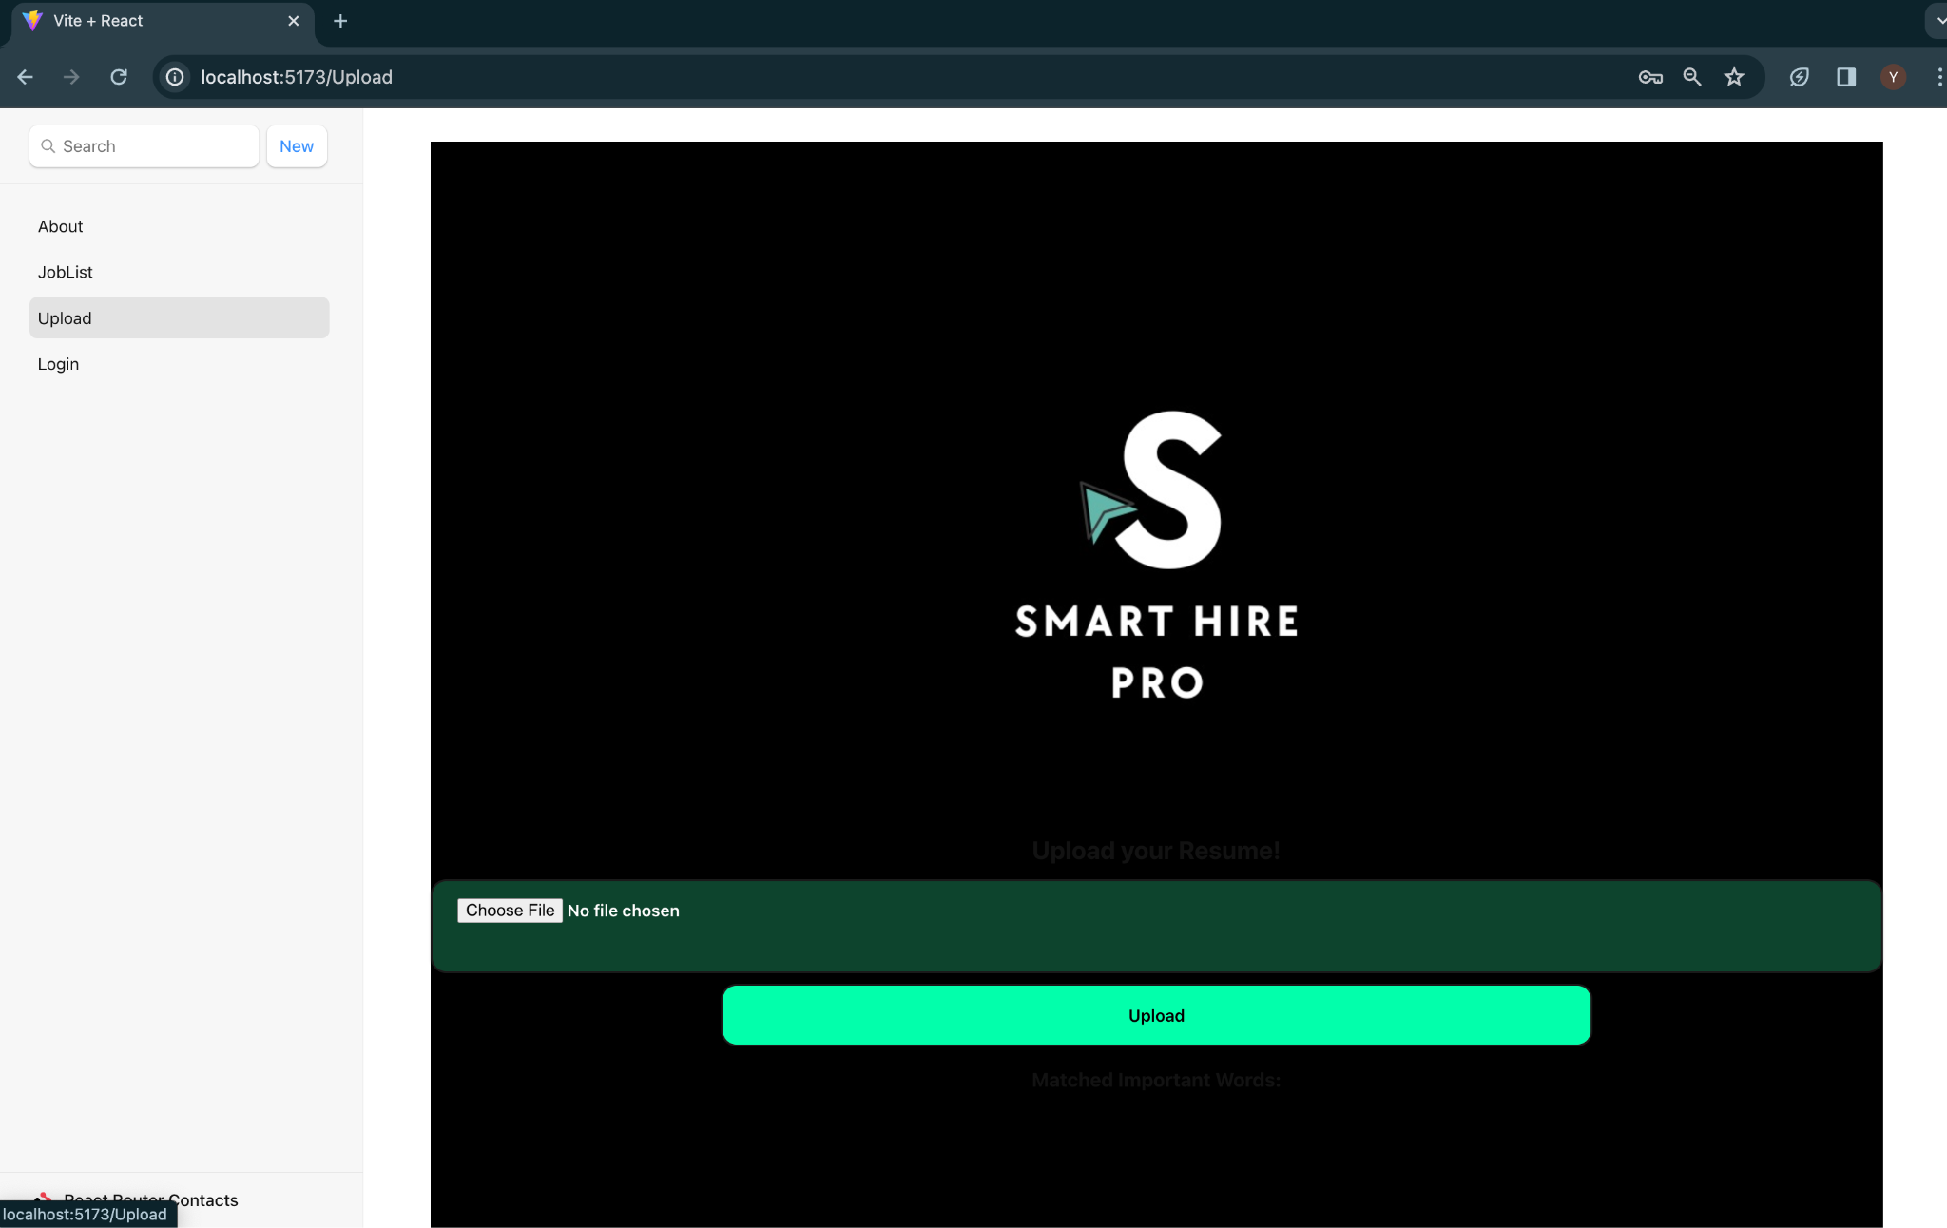
Live Demo

Slide 58
THANK YOU!
SmartHirePRO By Team Kodak

